Slide 1
Realtime anomaly detection
Review-3
2320030301- K.Sahitya
2320030296- K.Srirjith
2320090050- K.Jaikanth

Slide 2
TABLE OF CONTENTS
Review2 Comments
Introduction
Module-wise Implementation
Comparison and Discussion
Results
Conclusion
Future Direction
References

Slide 3
Review2 comments
Include INTRODUCTION

Slide 4
INTRODUCTION
In today’s digital world, large volumes of data are generated continuously from sources such as industrial systems, financial transactions, network traffic, and IoT devices. Monitoring this data in real time is essential to detect unusual patterns or anomalies that may indicate system failures, fraud, or security threats.
Traditional anomaly detection methods rely on static thresholds and batch processing, which are not effective for handling high-speed streaming data. These approaches often fail to detect complex patterns and may result in delayed responses.
To overcome these limitations, this project proposes a Real-Time Anomaly Detection System that processes continuous data streams using modern big data technologies and machine learning algorithms. The system integrates Kafka for data streaming, Spark for real-time processing, and Isolation Forest for anomaly detection.
By analyzing data as it is generated, the system enables early detection of abnormal events and provides real-time visualization through an interactive dashboard. This improves system reliability, enhances security, and supports efficient decision-making.

Slide 5
MODULE-WISE IMPLEMENTATION
1. Data Generation Module
Synthetic data is generated using the Faker library in Python to simulate real-world streaming scenarios.
The generated data includes attributes such as:
transaction ID
timestamp
system metrics (e.g., CPU usage, temperature, or transaction amount)
This module ensures a continuous flow of realistic input data for the system.
2. Data Streaming Module
Apache Kafka is used as the real-time data streaming platform.
A Kafka Producer sends generated data continuously to Kafka topics.
Kafka ensures:
high throughput
fault tolerance
scalable data ingestion

Slide 6
3. Stream Processing Module
Apache Spark Structured Streaming is used to process incoming data from Kafka.
Performs real-time operations such as:
data cleaning
filtering invalid values
feature extraction
normalization
Enables low-latency processing of continuous data streams.
4. Anomaly Detection Module
The Isolation Forest algorithm is implemented using Scikit-learn.
The model is trained on normal data patterns.
For incoming streaming data:
anomaly scores are calculated
data points are classified as Normal or Anomaly
Helps in detecting unusual behavior automatically without manual rules.
5. Storage Module
Processed results are stored in:
SQLite database (for structured storage)
or InfluxDB (for time-series data)
Stores:
predictions
ground truth values
timestamps
Enables performance evaluation and historical analysis.

Slide 7
6. Visualization Module
A real-time dashboard is developed using Streamlit and Plotly.
Displays:
live data streams
anomaly alerts
performance graphs
Helps users monitor system behavior and detect issues instantly.
7. Integration & Deployment Module
All components are integrated using Docker and Docker Compose.
Ensures:
easy deployment
environment consistency
scalability across systems

Slide 8
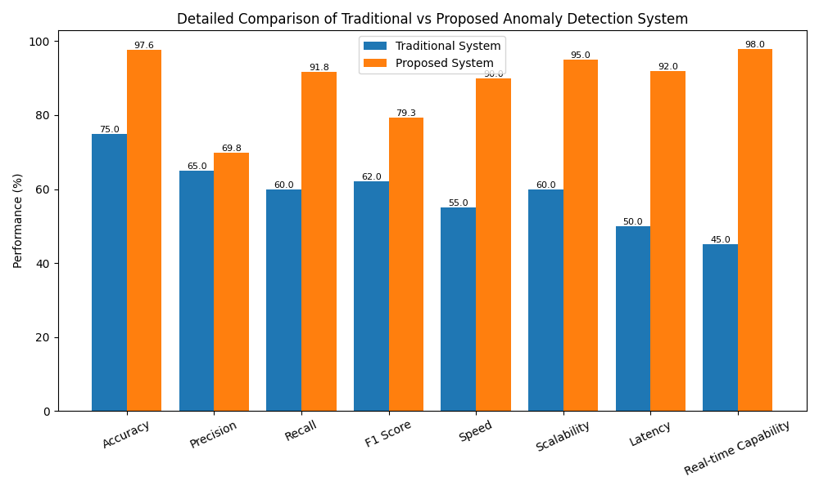
COMPARISON

Slide 9
DISCUSSION
The proposed system shows significant improvement in accuracy (97.58%) compared to traditional methods.
Recall is very high (91.78%), which ensures most anomalies are detected.
Traditional systems have lower performance due to static rules and batch processing.
The proposed system uses machine learning and real-time streaming, leading to:
faster detection
better scalability
lower latency
Improved real-time capability (98%) makes it suitable for modern streaming applications.

Slide 10
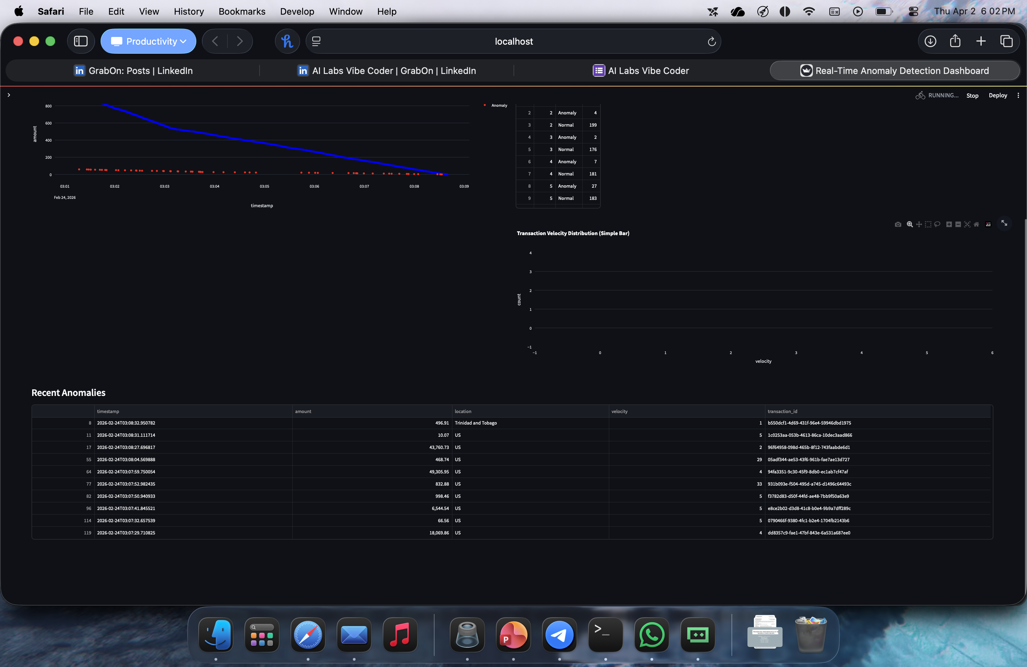
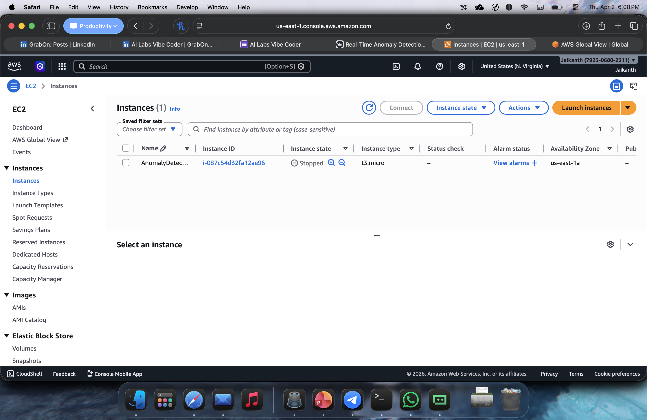
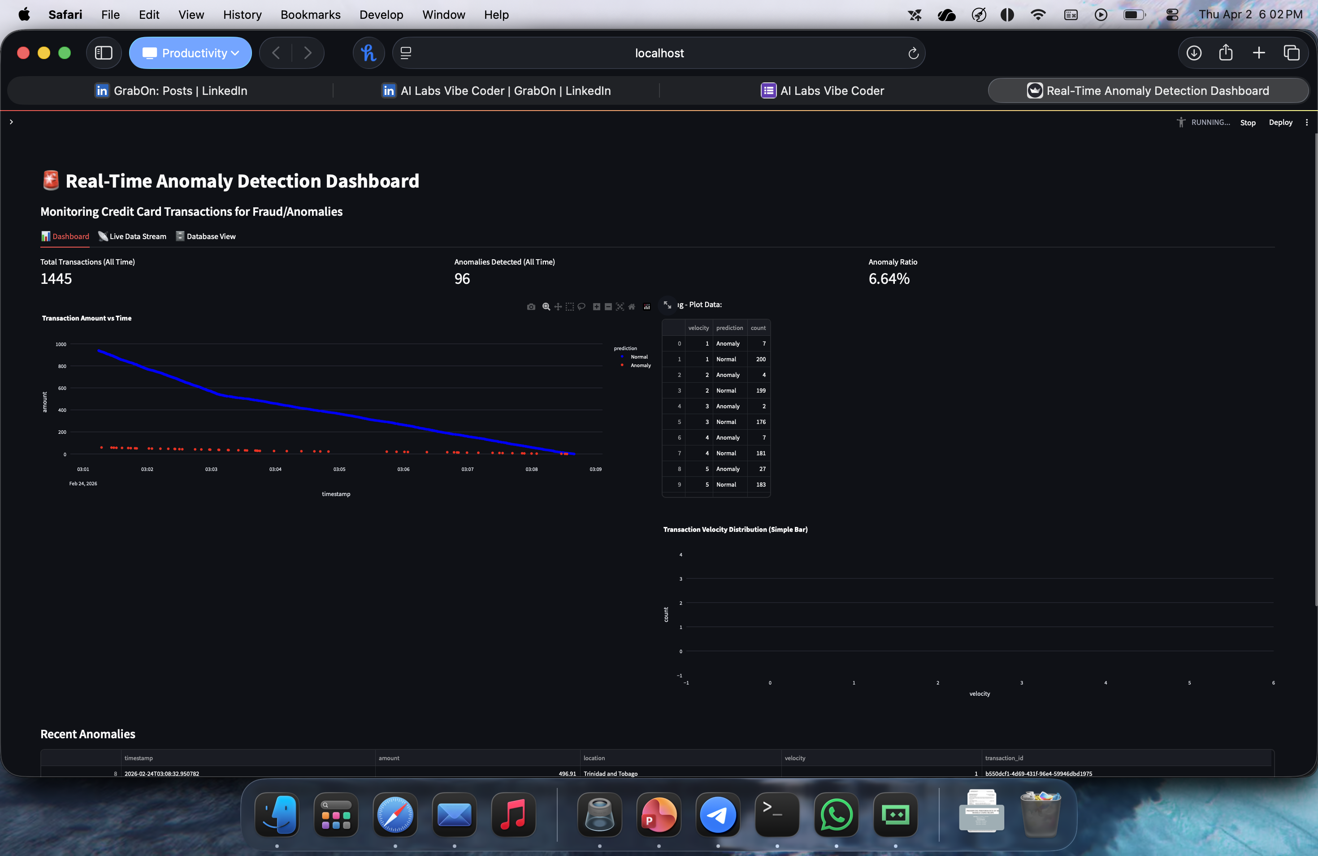
RESULTS

Slide 11
CONCLUSION
This project successfully implements a Real-Time Anomaly Detection System using streaming technologies and machine learning.
The system integrates:
Kafka for real-time data streaming
Spark for stream processing
Isolation Forest for anomaly detection
It effectively identifies abnormal patterns in continuous data streams and provides real-time visualization through a dashboard.
The results demonstrate that the system achieves high accuracy and strong detection capability, making it suitable for applications such as system monitoring, fraud detection, and industrial analytics.
Overall, the proposed system provides a scalable, efficient, and automated solution for detecting anomalies in real-time environments.

Slide 12
FUTURE DIRECTION
The system can be further improved with the following enhancements:
Advanced Models: Implement deep learning models such as LSTM or Transformer-based models for better accuracy.
Cloud Deployment: Deploy the system on cloud platforms (AWS, Azure, GCP) for scalability and real-time access.
Edge Computing Integration: Enable anomaly detection directly on IoT devices for faster response.
Alert System: Add automated real-time alerts (email/SMS notifications) for detected anomalies.
Model Optimization: Reduce false positives by using ensemble methods or hybrid models.
Real-world Data Integration: Replace synthetic data with real industrial or financial datasets.

Slide 13
REFERENCES
Isolation Forest https://ieeexplore.ieee.org/document/4781136
LSTM-based Encoder-Decoder for Multi-sensor Anomaly Detection https://arxiv.org/abs/1607.00148
Detecting Spacecraft Anomalies Using LSTMs and Nonparametric Dynamic Thresholding https://arxiv.org/abs/1802.04431
Anomaly Detection: A Survey https://doi.org/10.1145/1541880.1541882
Collective Anomaly Detection Based on Long Short-Term Memory Recurrent Neural Networks https://link.springer.com/chapter/10.1007/978-3-319-48057-2_15
LOF: Identifying Density-Based Local Outliers https://dl.acm.org/doi/10.1145/342009.335388
Deep Autoencoding Gaussian Mixture Model for Unsupervised Anomaly Detection https://arxiv.org/abs/1802.03903
Robust Principal Component Analysis? https://doi.org/10.1145/1970392.1970395
A Survey on Deep Learning for Anomaly Detection https://arxiv.org/abs/1901.03407
Time-Series Anomaly Detection Service at Microsoft https://arxiv.org/abs/1906.03821

Slide 14
THANK YOU

